Slide 1
MSF Project Demo
Kathy. Gao;

Slide 2
MSF Project Presentation
Data Source and Objectives
Explorative Data Visualization
Dependence Study
Supervised Learning Mortality Study
ATB Resistance Monte Carlo Simulation
Prototypes and other Protocols

Slide 3
Data Source
REDCap Database;
Data Collected by field agents of MSF
Including: Haiti Burn Wound data; Peshawar Neonate data; Central Africa Republic data; Amman, Syria, Yemen and Iraq data; Field Agent data

Slide 4
Objectives
Bacteria and Mortality Visualization
ATB Resistance Study;
Wound Treatment Protocol;
Mortality Study and Prediction;

Slide 5
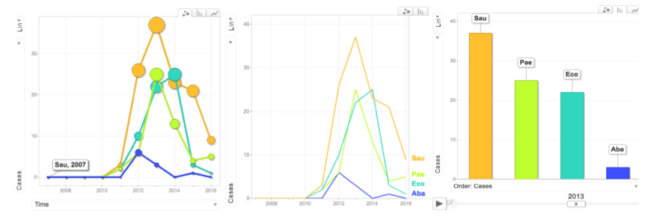
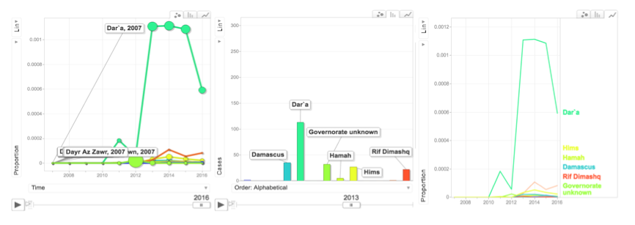
EDAV _ Pathogens ~ Patient

Slide 6
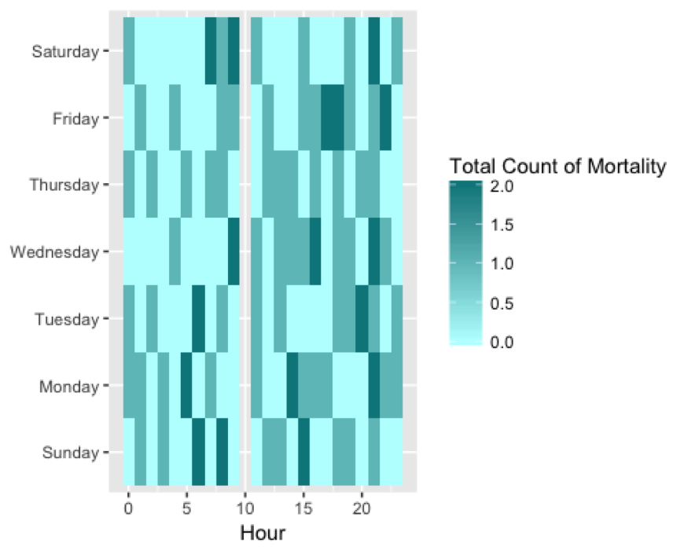
Mortality Tracking System

Slide 7
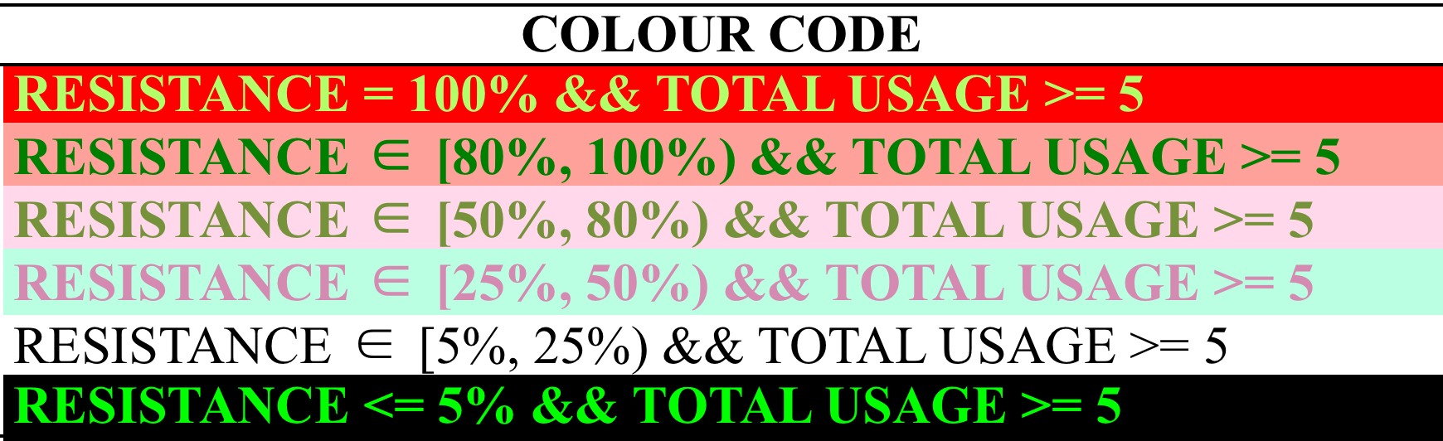
EDAV_ATB Resistance _ Table

Slide 8
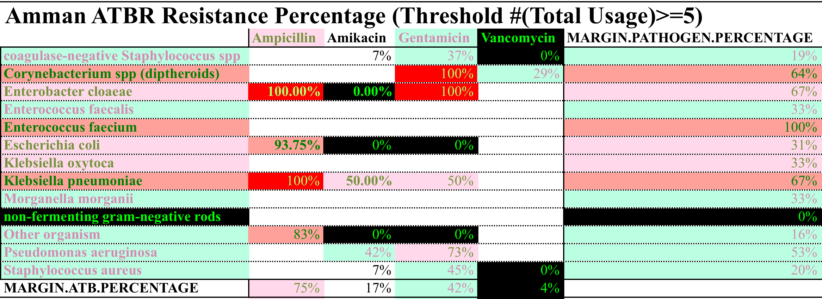
EDAV_ATB Resistance _ Table

Slide 9
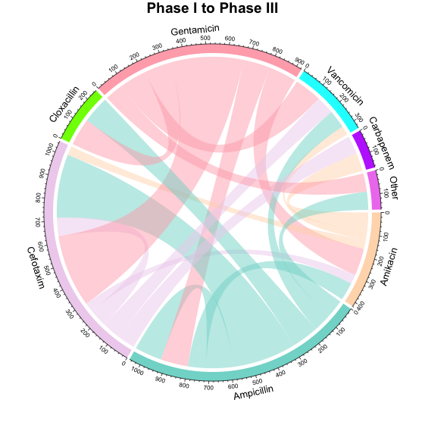
EDAV_ATB Resistance _ Circle Plot

Slide 10
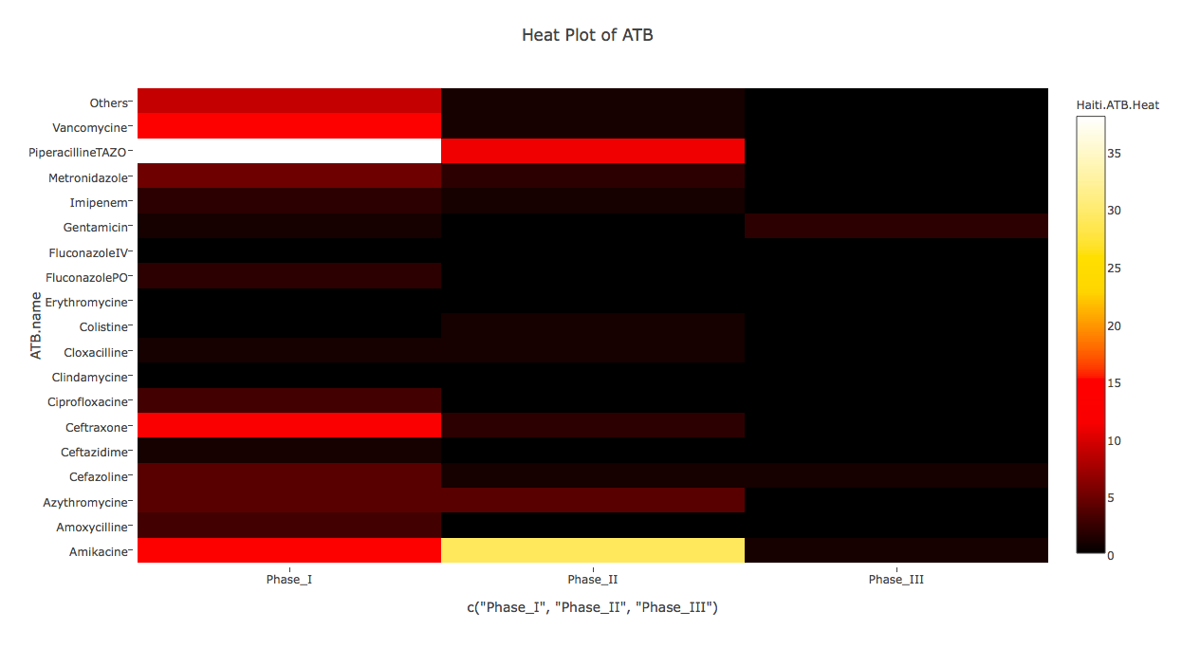
EDAV_ATB Resistance _ Heat Map

Slide 11
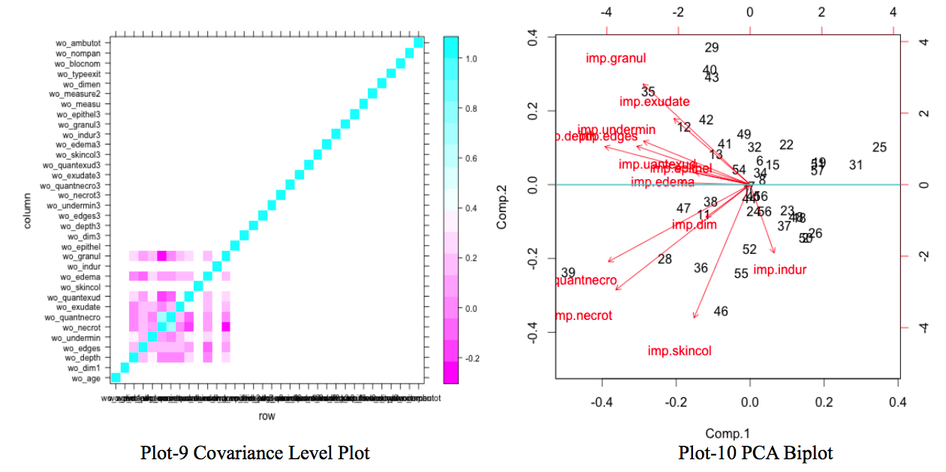
Dependence Study

Slide 12
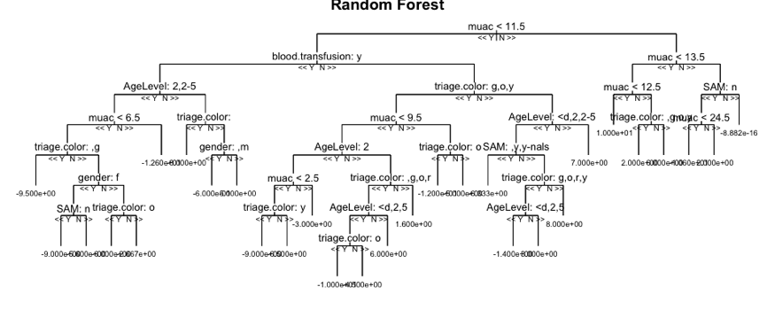
Supervised Learning _ PEW Score

Slide 13
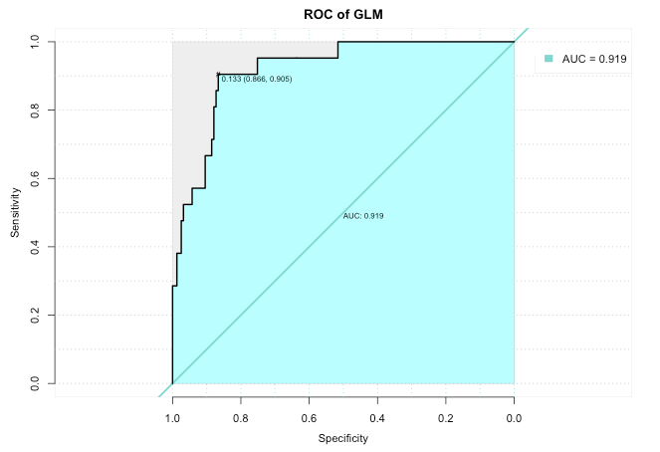
Supervised Learning _ Neonate Mortality

Slide 14
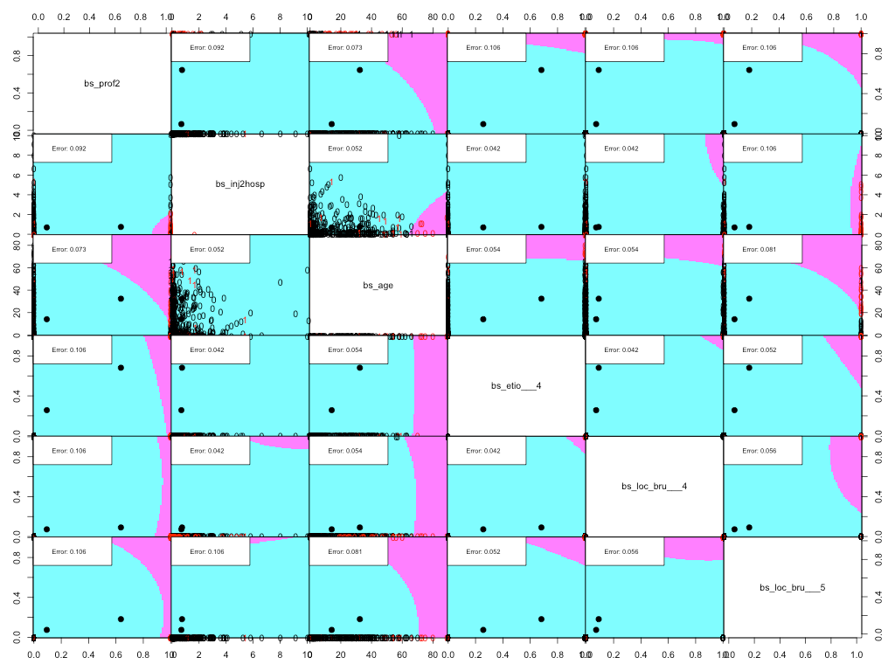
Supervised Learning _ General Mortality

Slide 15
Stochastic Simulation
What does Bacteria Invasion Look Like?
Immune System:
Killing Small proportion of bacteria, continuously
ATB:
Killing large proportion of bacteria
What Happens within loop?
Always:
Exponential Growth of Bacteria & Immune System Functioning;
Maybe:
ATB Injection and Bacteria Learn Resistance;
Bacteria Mutation and ATB Resistance
Terminal Conditions
Dropbox

Slide 16
ATB Procedure

Slide 17
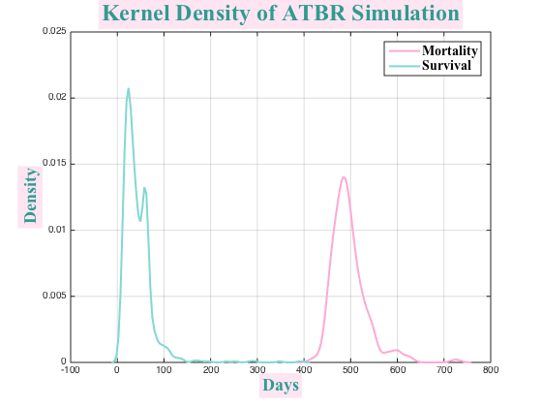
Stochastic Simulation
Let’s Run a small sample simulation right now!

Slide 18
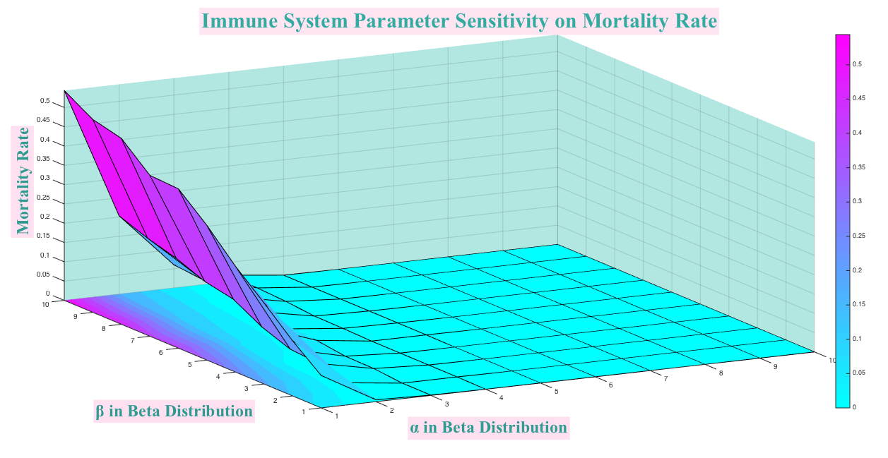
Sensitivity Test
Let’s Run a small sample simulation right now!

Slide 19
Further Discussion
Hidden Players
Intervention
Calibration

Slide 20
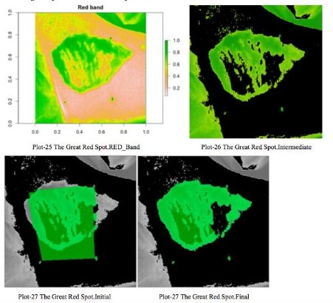
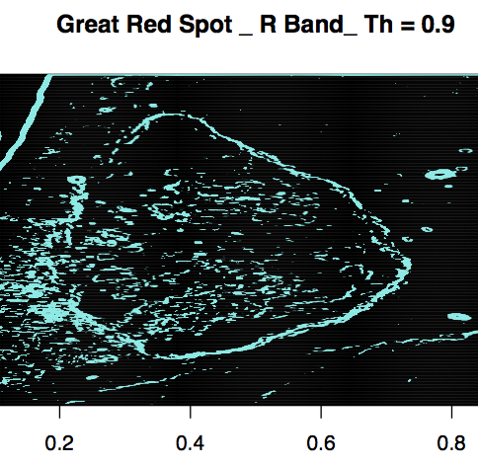
Prototype _ Image Processing
Image Segmentation
Boarder Detection

Slide 21
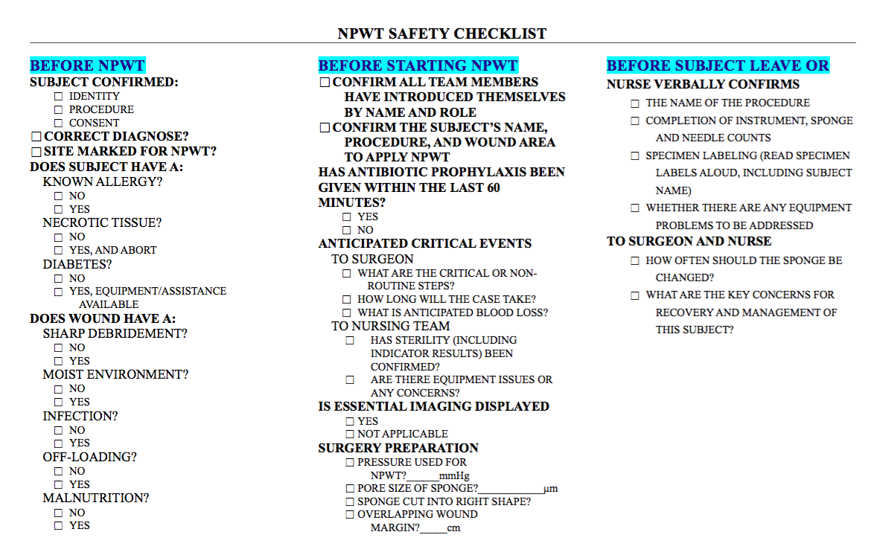
Protocol _ NPWT Safety Checklist

Slide 22




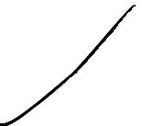















Q & A
cg2908@columbia.edu

